Slide 1
Should Data Models be Implemented in Azure Synapse Analytics or Power BI Premium?
Kyle Akepanidtaworn, Global Cloud Solution Architect (Power BI Champ)
Gananda Hayardisi, Area Cloud Solution Architect (Power BI Champ)
Wipada Chanthaweethip, Area Cloud Solution Architect (Power BI Champ)

Slide 2






Modern Data Warehouse Generic Pattern
Data Platform Management
Component Orchestration
Business Workflow
Service Configuration
Source
(On Premise)
Ingest & Store
Serving/ Consumption Layer
Clients
Ingestion
Landing/ Raw
Curated
Presentation
Data Warehouse
Data Science Capability
Citizen Analytics portal
Web client
Streaming Data
Transformed
Memory Optimised
Massive Parallel Processing
Clustering
Access across Structured and Unstructured Sources
Data and Cognitive APIs and Enterprise Search
Mobile client
Edge (On Premise)
No Transformation
Structured Data
ML Capability
Traditional BI Solutions
Collaboration client
Data Brokerage & BI Capability
Transformation
Spatial Data
Immutable
Data brokerage portal and Marketplace
3D/4D Visualisation. VR
Unstructured Data
Transformed
Analytical Engine
Data exploration portal (all data, NLQ, spatial)
OLAP
Connect Multiple Sources
App Development Capability
Enterprise Search and NLP
Source (Cloud)
Edge (Cloud)
No Transformation
Access Management
KPI and Metric Management
Composite Apps (HPC + Data + ML)
3rd party apps
Web
SaaS
Governance and Operations
DevOps
Service Management
Security
Governance
Platform Analytics
Data Management
Master Data
Meta Data
Lineage
Life Cycle
Archive
Quality
Credit: © Wagdy Issac, Data Adoption Framework (2019)

Slide 3



Microsoft Azure is the only cloud provider to unify AI, BI, and Analytics creating accelerated time-to-insight
On-premises data
Azure Machine Learning
Cloud data
Devices data
Azure Synapse Analytics
Power BI
SaaS data
Store
Azure Data Lake Storage

Slide 4
BI Solution Pattern I
Data Models in Azure Synapse Analytics
Notes:
Establishing a modern data estate is a foundational step toward digital transformation. A modern data estate enables timely insights and decision making across all your data, and sets the foundation for AI. A data estate is all of the data an organization owns. When you migrate this data to the cloud or modernize your environment on-premises you can gain important insights to fuel innovation.

Slide 5


Reference Architecture
Data Storage
Data Serving
Data Visualization
Data Sources
Logs (unstructured)
Storage Account
ADLS Gen 2
Azure Synapse Analytics (Spark + Serverless + DWH)
Power BI Premium
Media (unstructured)
Files (unstructured)
Low-cost, tiered storage, with high availability/disaster recovery capabilities.
limitless analytics service that
brings together enterprise data warehousing and Big Data analytics
Leader in the Magic
Quadrant for BI and Analytics
Business/ custom apps (structured)
Governance & Enterprise Security

Slide 6
Reference Architecture
Data Storage
Data Serving
Data Visualization
Data Sources
Enterprise data models can be deployed to a Synapse SQL pool in Azure Synapse.
Logs (unstructured)
Storage Account
ADLS Gen 2
Azure Synapse Analytics (Spark + Serverless + DWH)
Power BI Premium
Media (unstructured)
Files (unstructured)
Low-cost, tiered storage, with high availability/disaster recovery capabilities.
limitless analytics service that
brings together enterprise data warehousing and Big Data analytics
Leader in the Magic
Quadrant for BI and Analytics
Business/ custom apps (structured)
Governance & Enterprise Security

Slide 7
Reference Architecture
Data Storage
Data Serving
Data Visualization
Data Sources
Enterprise data models can be deployed to a Synapse SQL pool in Azure Synapse.
Logs (unstructured)
Storage Account
ADLS Gen 2
Azure Synapse Analytics (Spark + Serverless + DWH)
Power BI Premium
Media (unstructured)
Leader in the Magic
Quadrant for BI and Analytics
Files (unstructured)
Low-cost, tiered storage, with high availability/disaster recovery capabilities.
limitless analytics service that
brings together enterprise data warehousing and Big Data analytics
HR Data Mart
Marketing Data Mart
Business/ custom apps (structured)
Data Warehouse
Sales Data Mart
Governance & Enterprise Security

Slide 8
Connection Mode
Use Power BI as visualization layer where the data are hosted in Azure Synapse Analytics
HR Data Mart
Marketing Data Mart
DirectQuery
Data Warehouse
Power BI
Sales Data Mart

Slide 9
Advantages
Enable analytics on large data with massive parallel processing (MPP)
Store in relational tables with columnar storage & columnar ordering
Use all or subset of the data in materialized views can get faster performance
Tune the performance with result set caching (so recomputation is not needed.)
Come with more complete security.
Row-level security (RLS)
Column-level security
Dynamic Data Masking
Get most up-to-date data from source → Single source of truth
It may no need Power BI Premium to handle large dataset
Possible for no data movement (serverless pool)

Slide 10
Disadvantages
There is a limit of 128 max concurrent queries in SQL DW and 1,024 max open concurrent connections. When the concurrency limit is exceeded, the request goes into an internal queue where it waits to be processed. When the connection limit is exceeded, connections will be refused with an error.
Slower dashboard performance & DirectQuery performance.
Cannot add new columns or create calculated column within Power BI
Cannot leverage DAX functionality due to some limitations
Query load depends on Synapse only
Auto date/time is unavailable
Synapse can only connect to a single Power BI workspace now

Slide 11
BI Solution Pattern II
Data Models in Power BI Premium
Notes:
Establishing a modern data estate is a foundational step toward digital transformation. A modern data estate enables timely insights and decision making across all your data, and sets the foundation for AI. A data estate is all of the data an organization owns. When you migrate this data to the cloud or modernize your environment on-premises you can gain important insights to fuel innovation.

Slide 12
Reference Architecture
Data Storage
Data Serving
Data Visualization
Data Sources
Logs (unstructured)
Storage Account
ADLS Gen 2
Azure Synapse Analytics (Spark + Serverless + DWH)
Power BI Premium
Media (unstructured)
Files (unstructured)
Low-cost, tiered storage, with high availability/disaster recovery capabilities.
limitless analytics service that
brings together enterprise data warehousing and Big Data analytics
Leader in the Magic
Quadrant for BI and Analytics
Business/ custom apps (structured)
Governance & Enterprise Security

Slide 13
Reference Architecture
HR Data Mart
Data Storage
Data Serving
Data Visualization
Marketing Data Mart
Data Sources
Sales Data Mart
Logs (unstructured)
Storage Account
ADLS Gen 2
Azure Synapse Analytics (Spark + Serverless + DWH)
Power BI Premium
Media (unstructured)
BI semantic models represent a semantic layer over enterprise models. They're built and maintained by BI developers and business users. BI developers create core BI semantic models that source data from enterprise models. Business users can create smaller-scale, independent models—or, they can extend core BI semantic models with departmental or external sources.
Files (unstructured)
Low-cost, tiered storage, with high availability/disaster recovery capabilities.
limitless analytics service that
brings together enterprise data warehousing and Big Data analytics
Leader in the Magic
Quadrant for BI and Analytics
Business/ custom apps (structured)
Governance & Enterprise Security

Slide 14
Connection Mode
Create Sematic Model (Dataset) in Power BI, by leveraging Composite model use aggregation table with Import model and detail or adhoc query with DirectQuery mode to Azure Synapse analytics
HR Data Mart
DirectQuery
Marketing Data Mart
Data Warehouse
Import
Power BI
Sales Data Mart
As Power BI Dataset

Slide 15
Advantages
Allow for faster query performance
Leverage DAX functionality
More flexible to combine with other dataset/ data sources
Time intelligence capabilities
As source still resides in Synapse, these functionality can be used (on the Synapse side though):
Materialized views
Result-set cache
Security
Row-level security (RLS)
Column-level security
Dynamic Data Masking

Slide 16
Disadvantages
Lack some part of the security, particularly column-level security
No Perspectives feature yet. Perspectives, in tabular models, define viewable subsets of a model that provide focused, business-specific, or application-specific viewpoints of the model
Need schedule to refresh data to keep data current - it may bottleneck if we have so many schedule at the same time
There’s a dataset size limit (400GB)
Large datasets can be enabled for all Premium P SKUs and Embedded A SKUs. The large dataset size limit in Premium is comparable to Azure Analysis Services, in terms of data model size limitations.

Slide 17
Decision Flow
Azure Synapse Analytics
Where will Data Mart be resided?
Power BI Premium
No
Your organization allow to extract data to 3rd party?
YES
YES
Are you certain that queries will hit Result-set cache?
No
YES
Do you have complex ETL/aggregations?
No
No
Do you want to leverage DAX functionality ?
YES
YES
Do you need near real-time data (DirectQuery)?
No

Slide 18
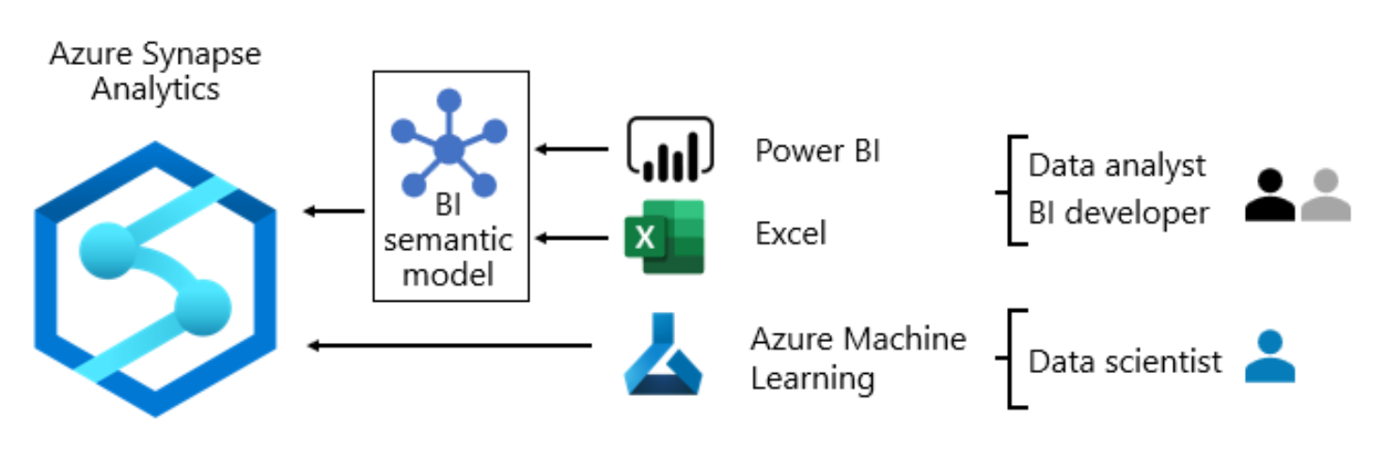
Reference Architecture
BI solution architecture in the Center of Excellence - Power BI | Microsoft Docs
Enterprise business intelligence - Azure Reference Architectures | Microsoft Docs
mspnp/azure-sqldw-enterprise-bi (github.com)
What is dedicated SQL pool (formerly SQL DW)? - Azure Synapse Analytics | Microsoft Docs
Azure Synapse Analytics & Power BI concurrency | James Serra's Blog
Large datasets in Power BI Premium - Power BI | Microsoft Docs
Azure SQL Data Warehouse with DirectQuery - Power BI | Microsoft Docs

Slide 19
Thank you

